Slide 1
HR Analytics - Turnover
Pawan Nagar

Slide 2
Problem Statement
HR is not just about hiring people it is an ocean of its own. HR department goes through a constant journey of finding, selecting, onboarding and monitoring the right talent. You are required to use analytics concept to provide a smooth monitoring of workforce for the HR department. Edward Babushkin is a Russian people analyst and prolific writer. Through his Russian blog he has built a large community of people analytics practitioners and has become the face of people analytics in the East. In one of his translated posts he poses the question: Which employee will be most likely to stay the longest, Johnson, Peterson, or Sidorson? In his support article, he than shows how to predict this using survival analysis. According to Edward, the data set is real – which is exciting! For the rest, the data is pretty straight forward. The only thing to keep an eye on is that some terms got lost in translation from Russian to English. As an example, ‘independ’ translates to a reversed scale of agreeableness, ‘self-control’ is conscientiousness, ‘anxiety’ is neuroticism, and ‘novator’ stands for openness.

Slide 3
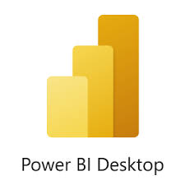

Tools used
Business Intelligence tools and libraries works such as Excel, Power BI are used to build the whole framework.

Slide 4
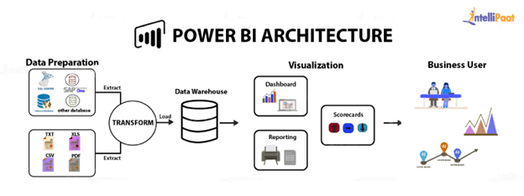
Power Bi Server Architecture
Power BI architecture is a service built on top of Azure. There are multiple data sources that Power BI can connect to. Power BI Desktop allows you to create reports and data visualizations on the dataset. Power BI gateway is connected to on premise data sources to get continuous data for reporting and analytics.
Power Bi Server is internally managed by the multiple server processes.
Data Preparation: -
Self-service data prep for big data in Power BI – Data flows can be used to easily ingest, cleanse, transform, integrate, enrich, and schematize data from a large array of transactional and observational sources, encompassing all data preparation logic.
Transform: -
Power BI Desktop to access SAP Business Warehouse (SAP BW) data. The SAP BW Connector Implementation 2.0 has significant improvements in performance and capabilities from version 1.0. Power BI Report Server is an on-premises report server with a web portal in which you display and manage reports and KPIs. Along with it come the tools to create Power BI reports, paginated reports, mobile reports, and KPIs. Your users can access those reports in different ways: viewing them in a web browser or mobile device, or as an email in their in-box.

Slide 5
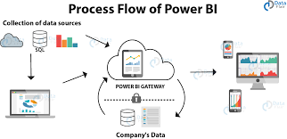
Data Warehouse: -
A data warehouse is a type of data management system that is designed to enable and support business intelligence (BI) activities, especially analytics. Data warehouses are intended to perform queries and analysis and often contain large amounts of historical data.
Visualization
Data visualization brings data to life, making you the master storyteller of the insights hidden within your numbers. Through live data dashboards, interactive reports, charts, graphs, and other visual representations, data visualization helps users develop powerful business insight quickly and effectively.
Process Flow of Power Bi

Slide 6
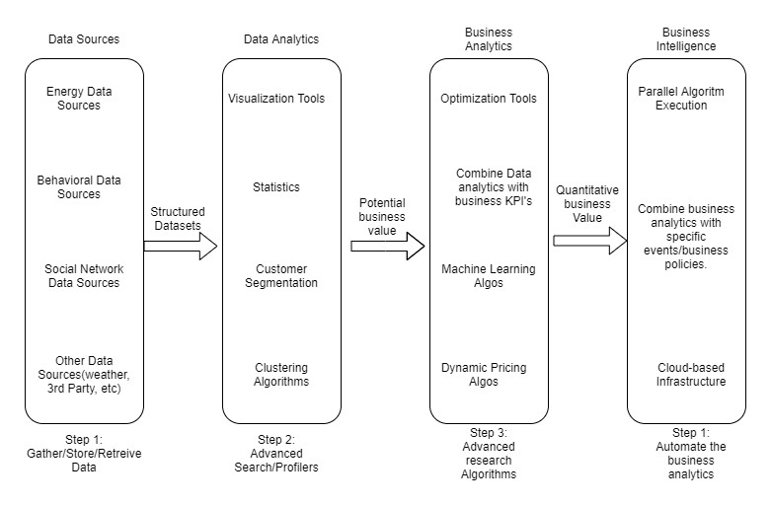
Functional Architecture
Figure 1: Functional Architecture of Business Intelligence

Slide 7
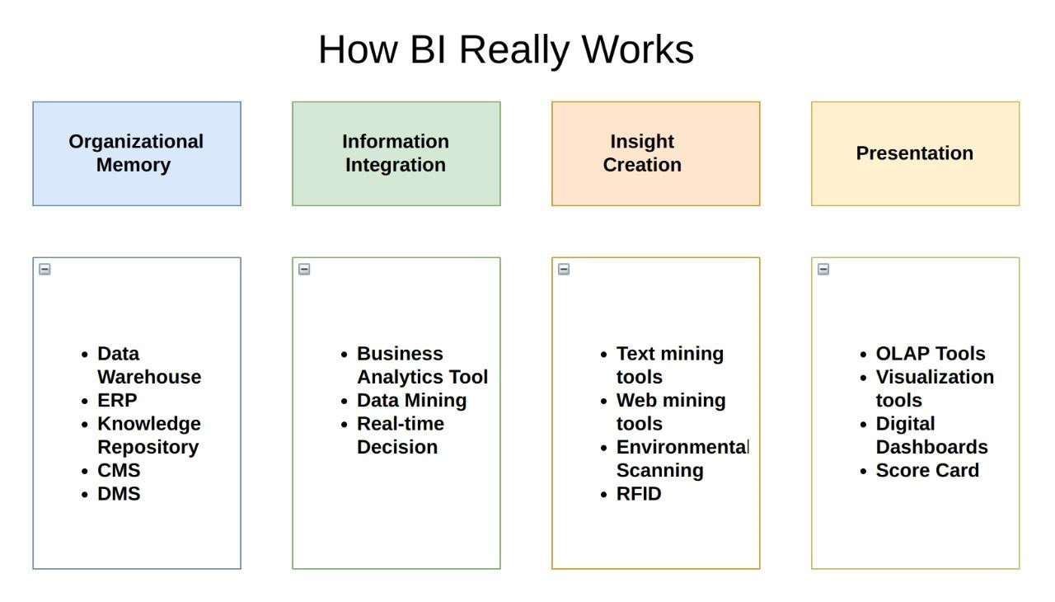
Optimization
Your data strategy drives performance
Minimize the number of fields
Minimize the number of records
Optimize extracts to speed up future queries by materializing calculations, removing columns and the use of accelerated views

Slide 8
Reduce the marks (data points) in your view
Practice guided analytics. There’s no need to fit everything you plan to show in a single view. Compile related views and connect them with action filters to travel from overview to highly-granular views at the speed of thought.
Remove unneeded dimensions from the detail shelf.
Explore. Try displaying your data in different types of views. Limit your filters by
number and type
Reduce the number of filters in use. Excessive filters on a view will create a more complex query, which takes longer to return results. Double-check your filters and remove any that aren’t necessary.
Use an include filter. Exclude filters load the entire domain of a dimension, while include filters do not. An include filter runs much faster than an exclude filter, especially for dimensions with many members.
Use a continuous date filter. Continuous date filters (relative and range-of-date filters) can take advantage of the indexing properties in your database and are faster than discrete date filters.
Use Boolean or numeric filters. Computers process integers and Booleans (t/f) much faster than strings.
Use parameters and action filters. These reduce the query load (and work across data sources).
Optimize and materialize your calculations
Perform calculations in the database
Reduce the number of nested calculations.
Reduce the granularity of LOD or table calculations in the view. The more granular the calculation, the longer it takes.
LODs - Look at the number of unique dimension members in the calculation.
Table Calculations - the more marks in the view, the longer it will take to calculate

Slide 9
Where possible, use MIN or MAX instead of AVG. AVG requires more processing than MIN or MAX. Often rows will be duplicated and display the same result with MIN, MAX, or AVG.
Make groups with calculations. Like include filters, calculated groups load only named members of the domain, whereas Tableau’s group function loads the entire domain.
Use Booleans or numeric calculations instead of string calculations. Computers can process integers and Booleans (t/f) much faster than strings. Boolean>Int>Float>Date>DateTime>String

Slide 10
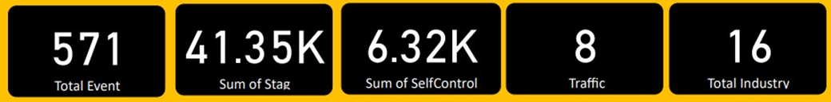
HR Turnover Analysis
Wireframe
As per the problem statement, we have divided analysis into three sections: -
Some Tiles for Quick Analysis:
In this section of dashboard, we tried to interpret the followings:-
First tile show that total event.
Second tile show that sum of stag.
Third tile show sum of Self-control.
Fourth tile show total count of Traffic.
Fifth tile show total industry.

Slide 11
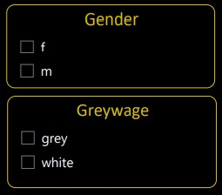
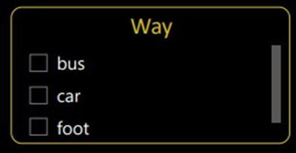
Filters Of Dashboard
Gender section represent type of Gender: - Male(M) and Female(F)
Greywage Section represent: - Grey and White
Way Section represent: - Travel Way

Slide 12
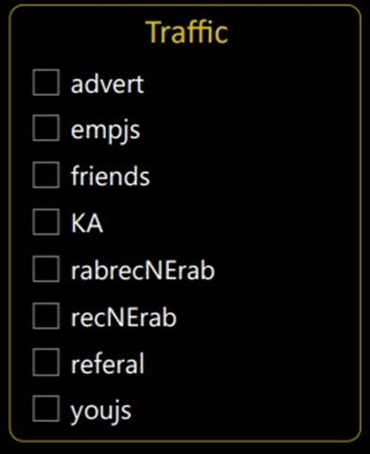
Traffic Section represent Like This(Some Data in Different Language-Russian)

Slide 13
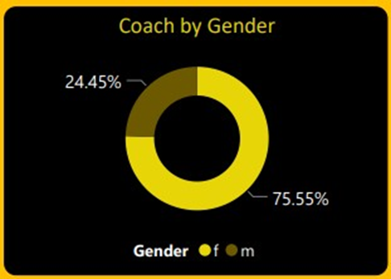
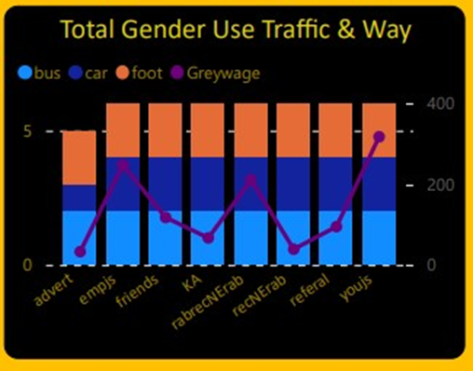
Gender Based Analysis Visuals
Here, we have our Dashboard interpret as follow: -
Coach by Gender
Total Gender Use traffic and Way

Slide 14
Thankyou !

